Slide 1


How to SAVE 33M€ / year
Meeting rganizer
Bernard PIRENNE
Franck ZIVKOVIC
Pascal VERDAGE
Romain LINSOLAS
Alexandre VICTOOR

Slide 2
Do you know this situation?
Notes:
Prepare a meeting :
Template meeting
Cost estimation
Collaboration space creation
Manage the meeting :
Gather minutes information
Live monitor (time keeper)
Time shower
Notification at mid of meeting
Notification 10’ before the end
Add doc / photos
Complete the meeting :
Return on time invested - ROTI
Rate on quality of the meeting (0 – 5)
Comment from participants
Post meeting notification
“Minutes todo” notif.
“No minutes” notif
V2 functions :
monthly report
speech recognetion
IOT (internet of things)

Slide 3
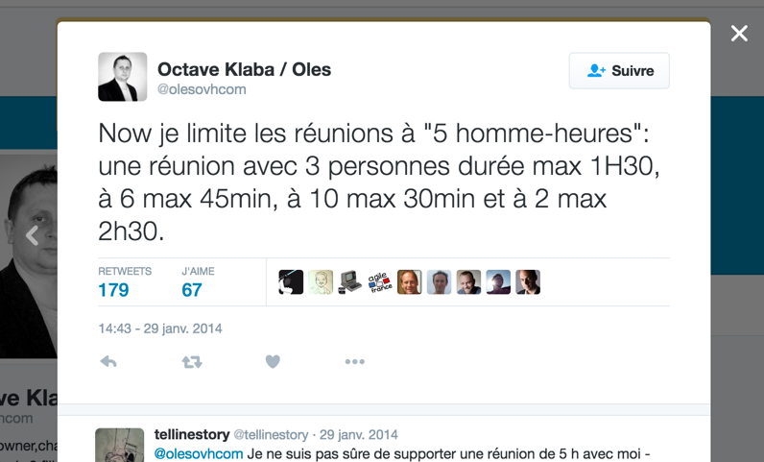
Meetings are toxic
OVH founder
37 Signals :
« One meeting leads to another meeting
leads to another ... »
Notes:
Prepare a meeting :
Template meeting
Cost estimation
Collaboration space creation
Manage the meeting :
Gather minutes information
Live monitor (time keeper)
Time shower
Notification at mid of meeting
Notification 10’ before the end
Add doc / photos
Complete the meeting :
Return on time invested - ROTI
Rate on quality of the meeting (0 – 5)
Comment from participants
Post meeting notification
“Minutes todo” notif.
“No minutes” notif
V2 functions :
monthly report
speech recognetion
IOT (internet of things)

Slide 4



Meeting rganizer
Gamification
Prepare
Manage
Complete
Outlook
Minutes and decision :
…..........................
….......................... …..........................
Template meeting
Cost estimation
Collaboration space
Gather minutes
Live monitor
Time keeper
Half time notification
10’ left notification
Add doc / photos
Return on time invested - ROTI
Rate (0 – 5)
Comment
Post meeting notification
“Minutes todo” notification.
“No minutes” notification
V2 functions :
monthly report
speech recognetion
IOT (internet of things)
Notes:
Prepare a meeting :
Template meeting
Cost estimation
Collaboration space creation
Manage the meeting :
Gather minutes information
Live monitor (time keeper)
Time shower
Notification at mid of meeting
Notification 10’ before the end
Add doc / photos
Complete the meeting :
Return on time invested - ROTI
Rate on quality of the meeting (0 – 5)
Comment from participants
Post meeting notification
“Minutes todo” notif.
“No minutes” notif
V2 functions :
monthly report
speech recognetion
IOT (internet of things)

Slide 5

Reduce time wasted
3000 $$
SAVINGS : 33M€ per year*
*Assumption : 1254 rooms in SG Paris x 5 peoples (avg) x 6 hours (avg) x 5% (participants less in meetings)
Notes:
« Have more efficient meeting and continuously improve your meeting practices»
Reduce time wasted :
be aware of meeting cost.
challenge necessity of all participants.
Estimation (only La defense):
1254 rooms x 5 peoples x 6 hours per day x 5% = 1881 man hours per day.
= 235 man days per day.
= 141k€ per day
= 33M € / year

Slide 6
Improve efficiency
“The shorter, the better”
half time
10’ left
« 70% of interest of a meeting is in the conclusion and follow up»
Notes:
Improve efficiency in the time invested :
be notify of half-time and end of meeting. (better time management)
sharing information in a collaborative mode
70% of interest of a meeting is in the conclusion

Slide 7
Improve quality of meeting outcomes
Context ?!
Feedbacks
Agenda !?
Feedback !?
Minutes !?
« Have more efficient meeting and continuously improve your meeting practices»
Notes:
Improve quality of meeting outcomes
Help meeting chairman to detail context
Better follow-up post-meeting
Notifications to promotes minutes.
Encourage feedback for improvement (preparation & post meeting)

Slide 8
Meeting organizer
DB
Store meetings
(data & statics)
Micro Meeting
UI
Initiate collaborative space
Get meeting minutes
Grant bonus to profiles
JIVE
Send pre and post
meeting notification
REST
SMTP
Create meeting
Force good practises
Rate meeting
Send live meeting notifications
(half and 10’ before end of the meeting)
Outlook
Outlook
Skype

Slide 9
Show Time !

Slide 10
Outlook addin
Time shower
Half meeting notification
10’ left notification

Slide 11
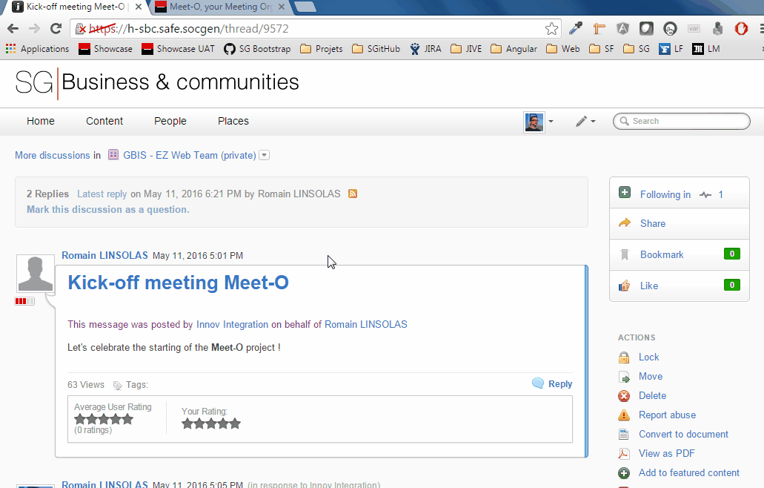
MEET-O

Slide 12
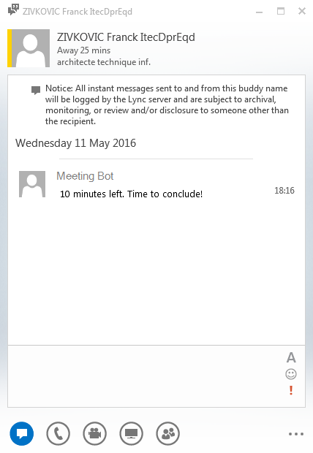
LIVE meeting notification
Time shower
Half meeting notification
10’ left notification
Notes:
Time shower
Notification at mid of meeting
Notification 10’ before the end

Slide 13
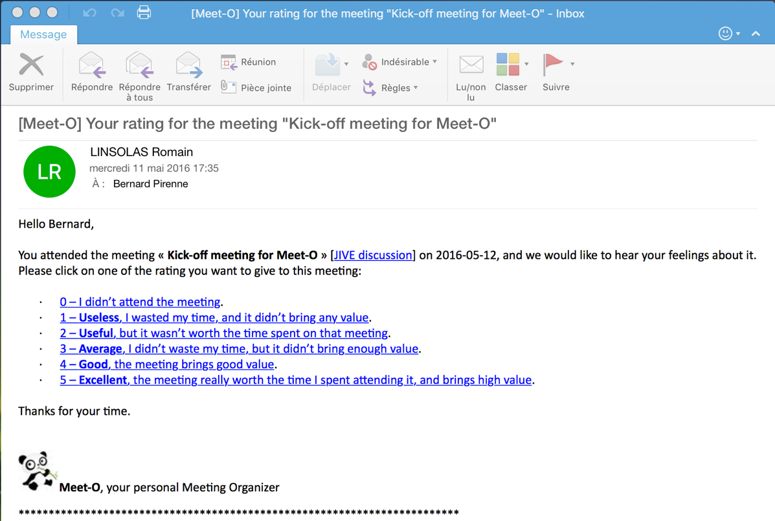
Post meeting notification
Rate meeting (0 – 5)
“Minutes todo” notif.
“No minutes” notif
Notes:
Post meeting notification
Rate on quality of the meeting (0 – 5)
“Minutes todo” notif.
“No minutes” notif

Slide 14
Thank you!

Slide 15
Annexe

Slide 16
Savings
SAVINGS : 33M€ per year ??
Estimation (only La defense):
1254 rooms x 5 peoples x 6 hours per day x 5% = 1881 man hours per day.
= 235 man days per day.
= 141k€ per day
= 33M € / year
=
Notes:
Estimation (only La defense):
1254 rooms x 5 peoples x 6 hours per day x 5% = 1881 man hours per day.
= 235 man days per day.
= 141k€ per day
= 33M € / year

Slide 17
Meeting organizer
Bernard PIRENNE
Franck ZIVKOVIC
Pascal Verdage
Romain Linsolas
Alexandre VICTOOR

